Slide 1
02
Pneumonia detection
based on
Traditional machine learning

Slide 2
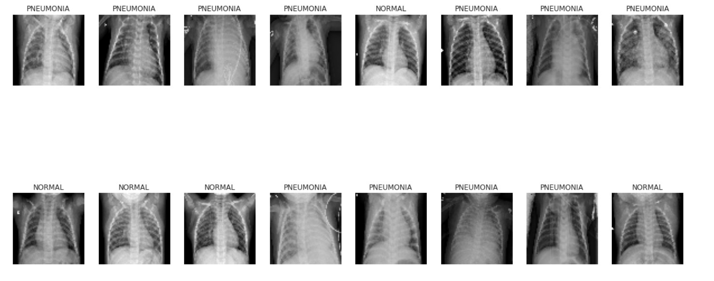
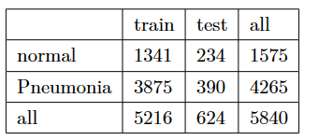


dataset
(64,64)
images and labels
load data
Labeled Optical Coherence Tomography (OCT)
and
Chest X-Ray Images for Classification
https://data.mendeley.com/datasets/rscbjbr9sj/2

Slide 3
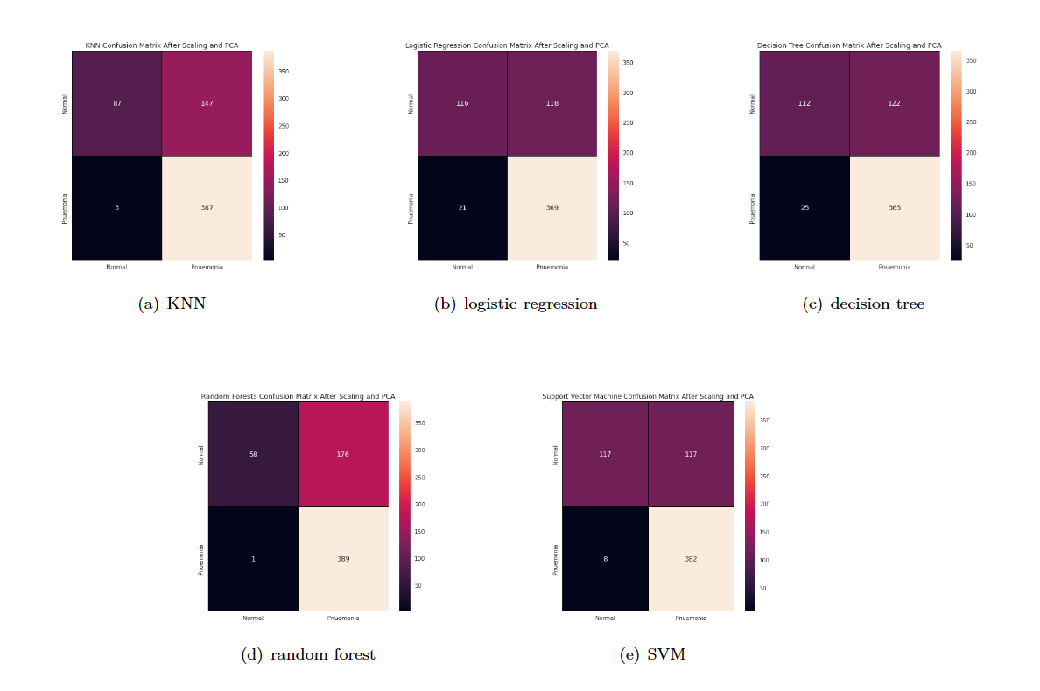
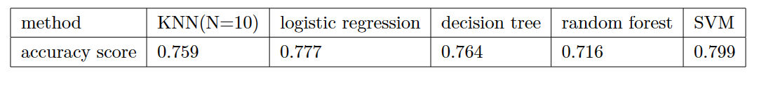
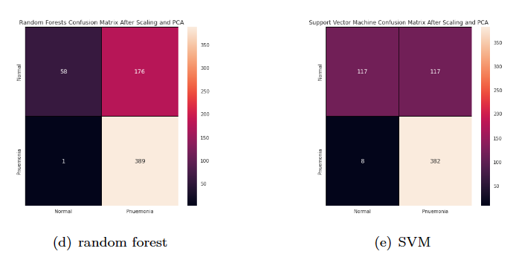
PCA:
remain 95% variance from 12288 to 546 dimension

Slide 4
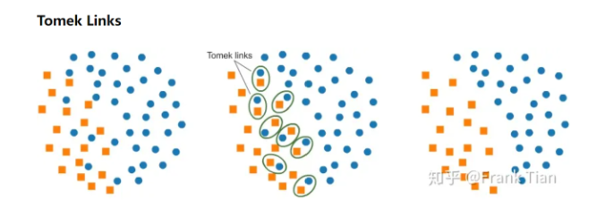
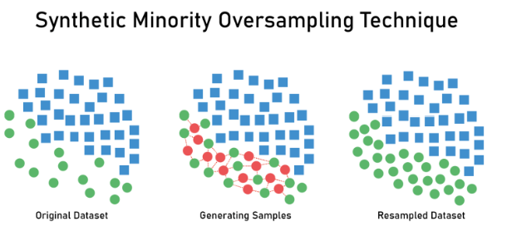
data balance
inbalanced!

Slide 5
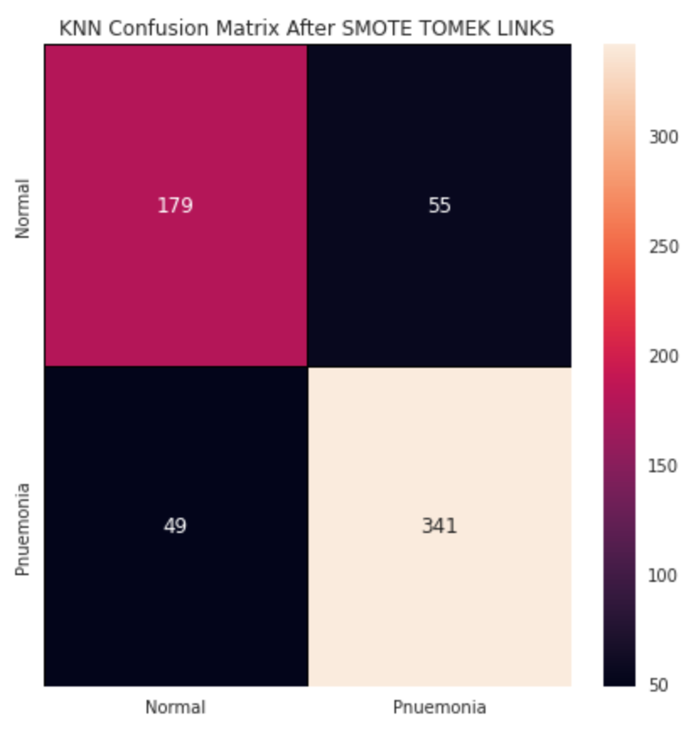
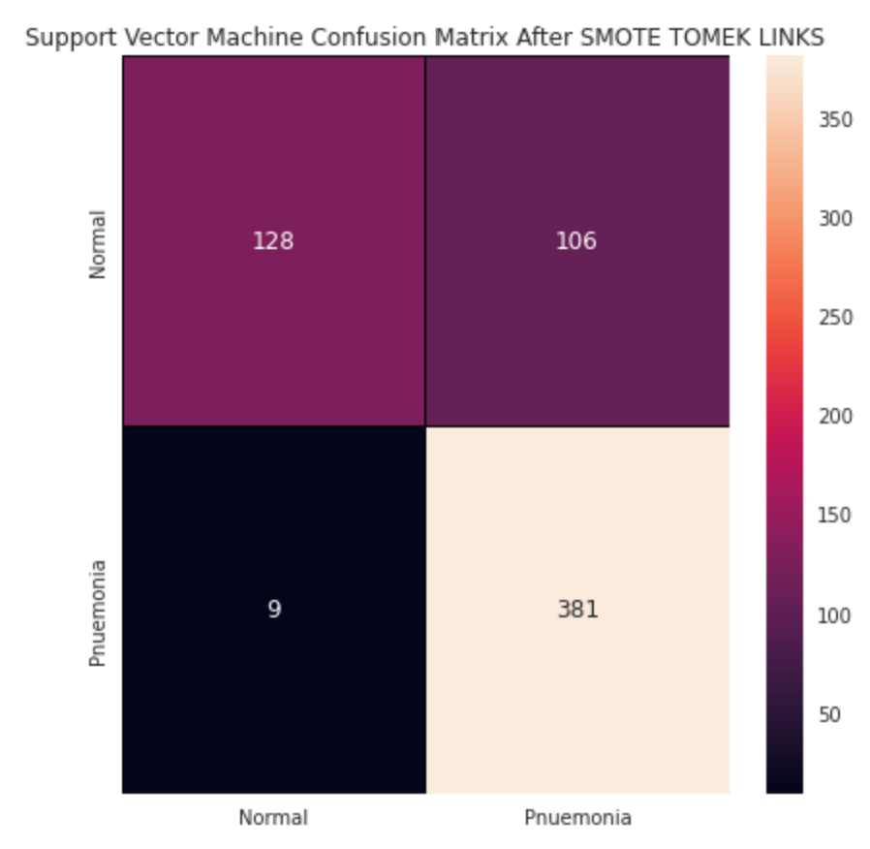
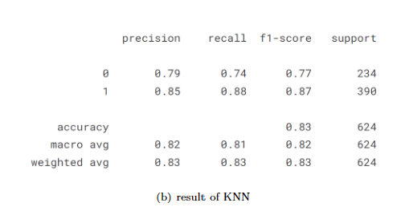

KNN and SVM
K=9

